Slide 1
Agile vs Waterfall SDLC
By: Jason Palmeri
10/17/2021
Assignment 1.1

Slide 2
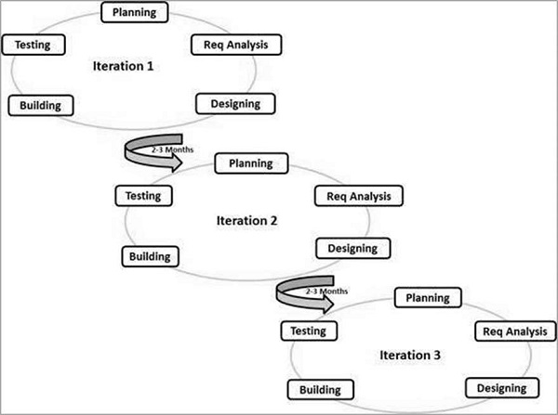
Agile SDLC
The Agile SDLC is a combination of iterative and incremental models focused on process adaptability and customer satisfaction by rapidly delivering a working software product.
Agile SDLC breaks a project into small incremental builds, each provided in iteration, where each iteration lasts from one to three weeks.
Each iteration can be broken up into:
Planning, Requirements Analysis, Design, Coding, Unit Testing, Acceptance Testing

Slide 3
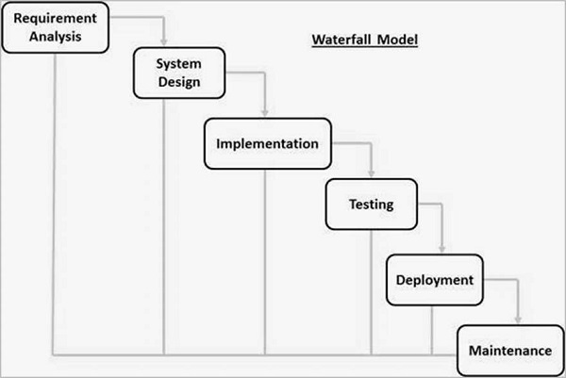
Waterfall SDLC
Also known as the Linear-Sequential Life Cycle Model, the Waterfall SDLC is a very simple to understand and use model, where each phase must be completed before the next phase can begin and there is no overlapping in the phases.
The waterfall model is the earliest SDLC approach that was used for software development

Slide 4
Comparison
Agile vs. Waterfall
Both follow similar modeling, each requiring:
Requirement Analysis
Design
Testing
Both deliver a fully functional product.
The difference between Agile and Waterfall is that Agile has two phases of testing, first is the unit testing to ensure the product works, then there is acceptance testing, which makes sure the product is right for the consumer. Waterfall SDLC has one phase of testing, where after it is tested they deploy the product, and then maintain it, while Agile SDLC does not maintain.
Similarities
Differences

Slide 5
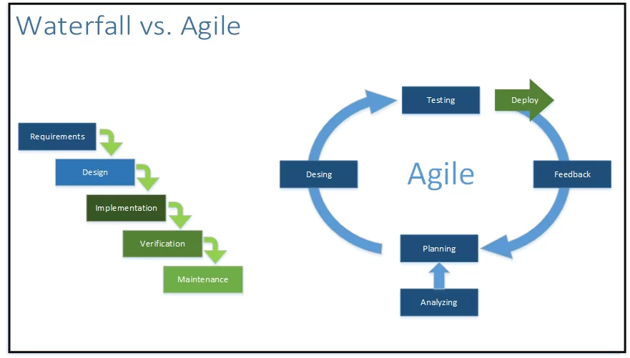
Which is Better?
Each SDLC has its pros and cons, and at the end of the day, the one that you choose is up to the project that it is being used on, as each one has a different mindset and work requirements.

Slide 6
Cite
Tutorialspoint. (n.d.). SDLC - Agile Model. Retrieved October 17, 2021, from https://www.tutorialspoint.com/sdlc/sdlc_agile_model.htm.
Tutorialspoint. (n.d.). SDLC - Waterfall Model. Retrieved October 17, 2021, from https://www.tutorialspoint.com/sdlc/sdlc_waterfall_model.htm.

